Slide 1
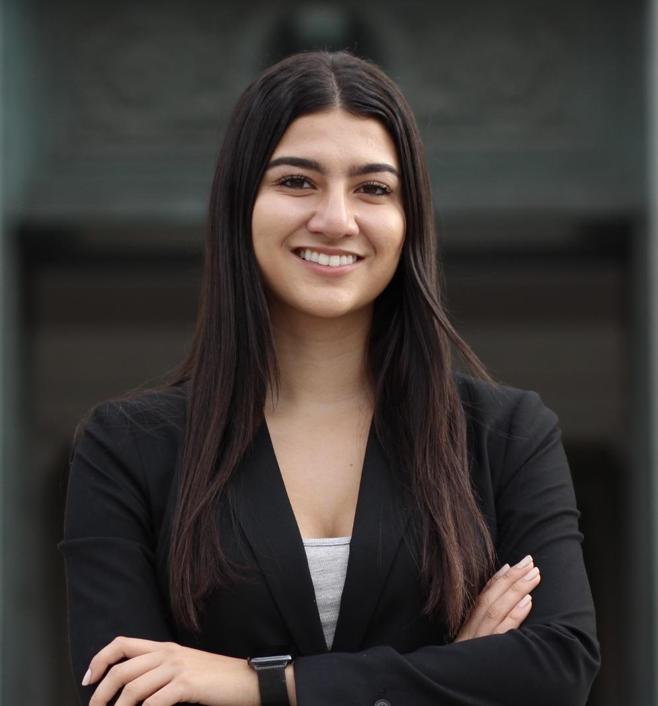
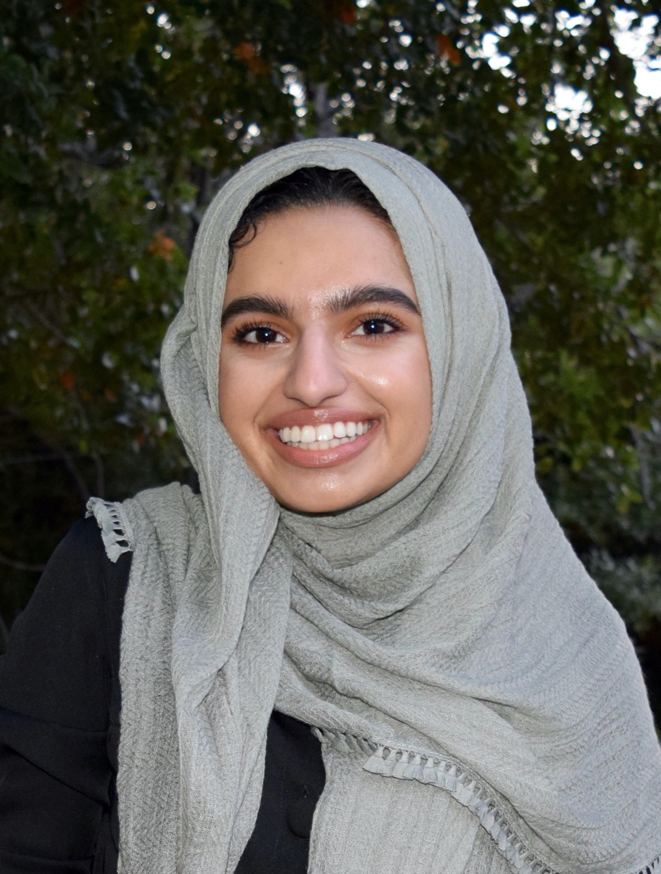
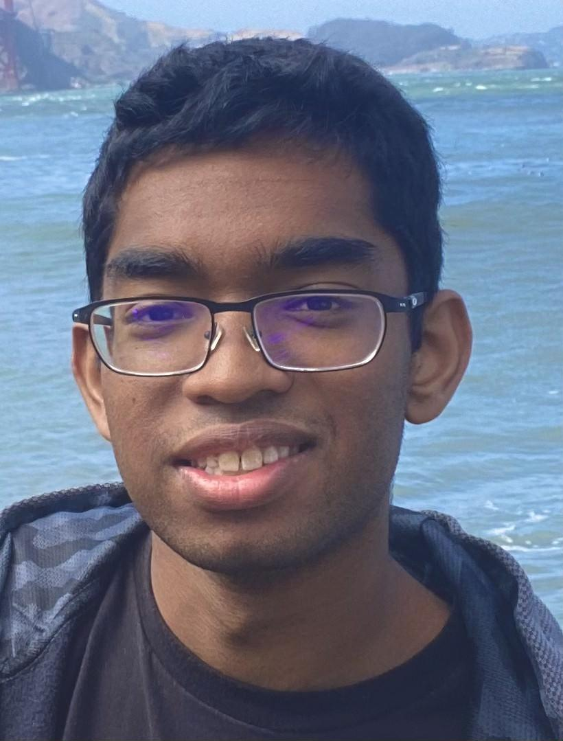
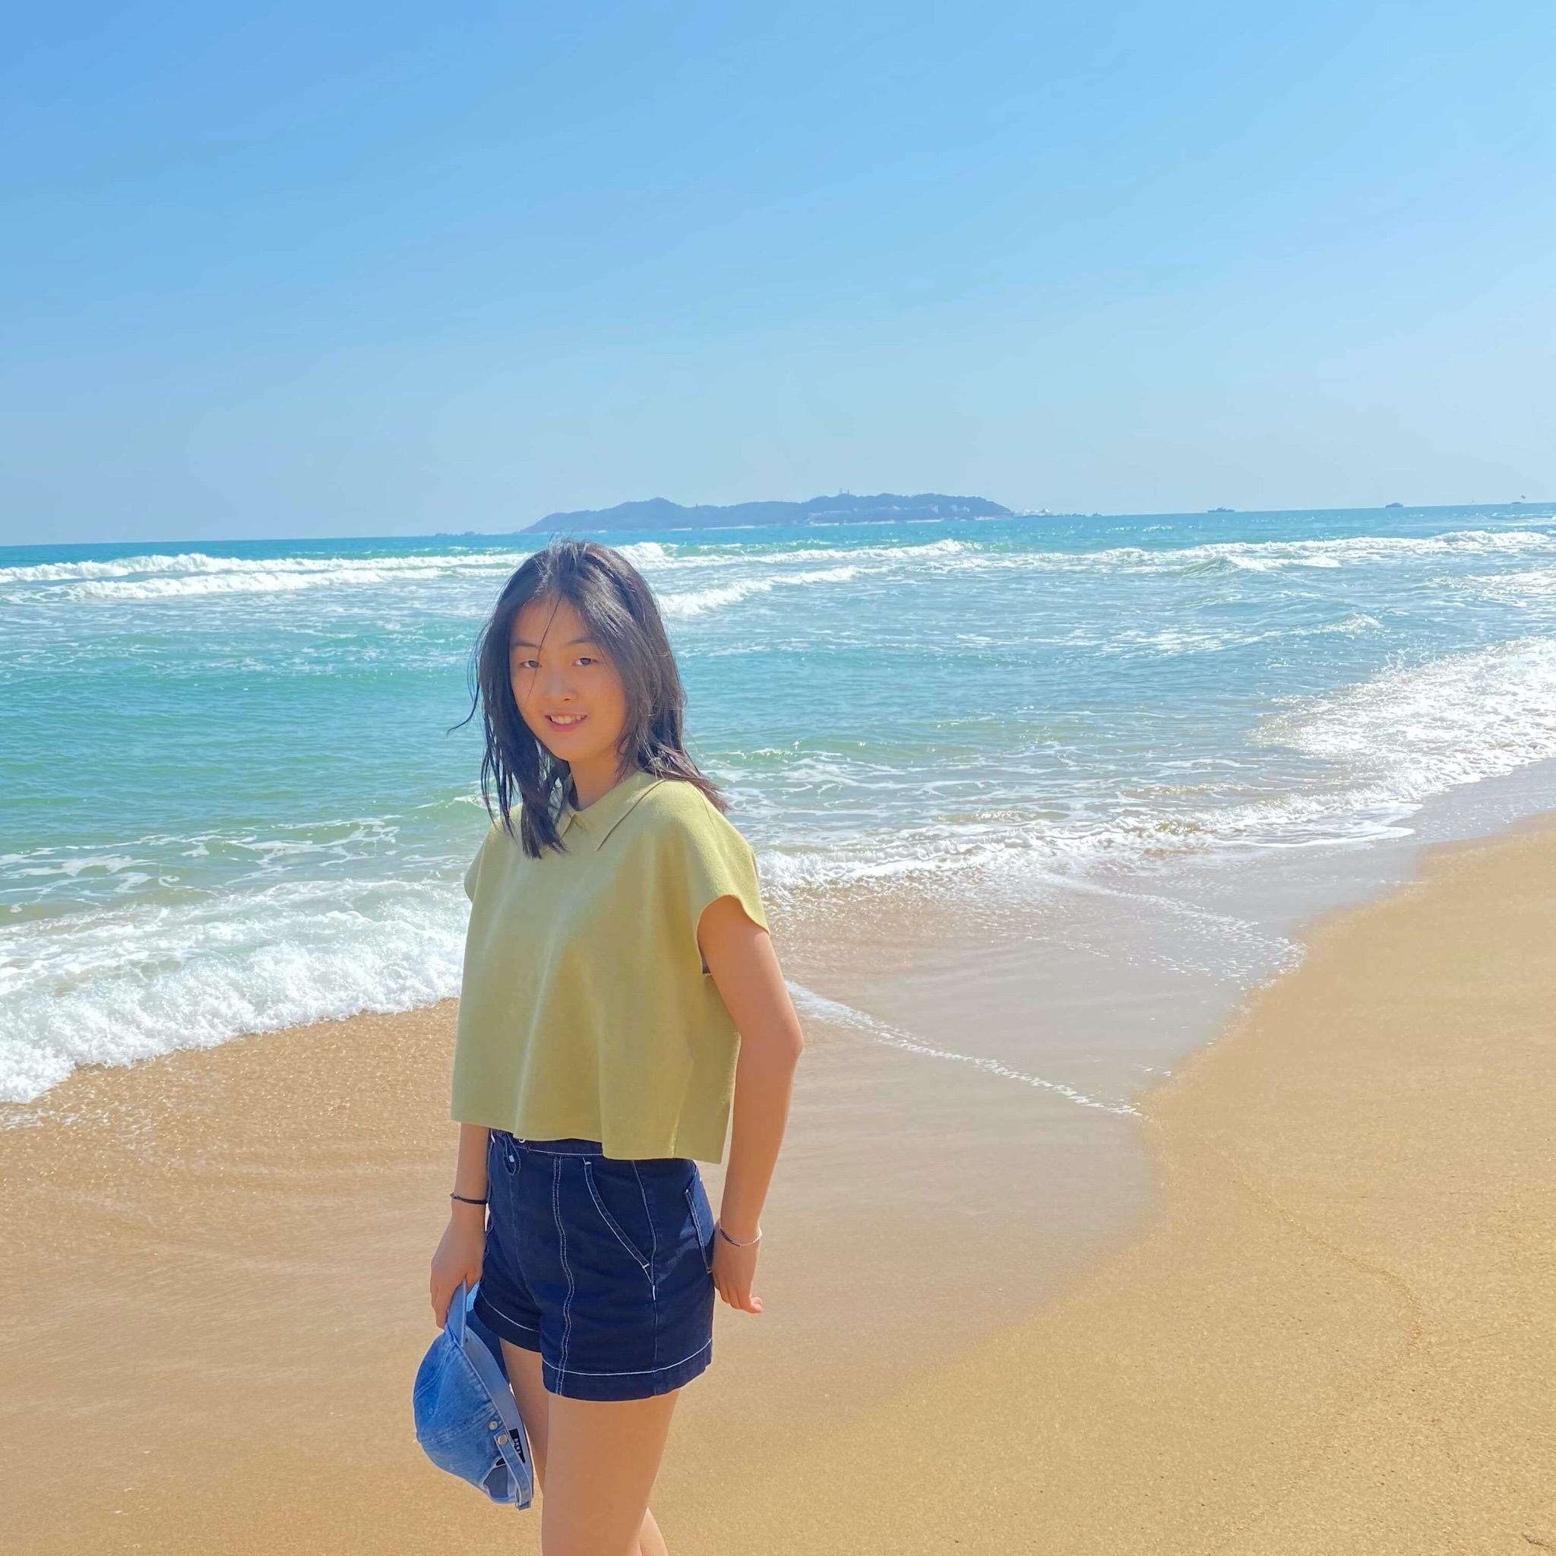
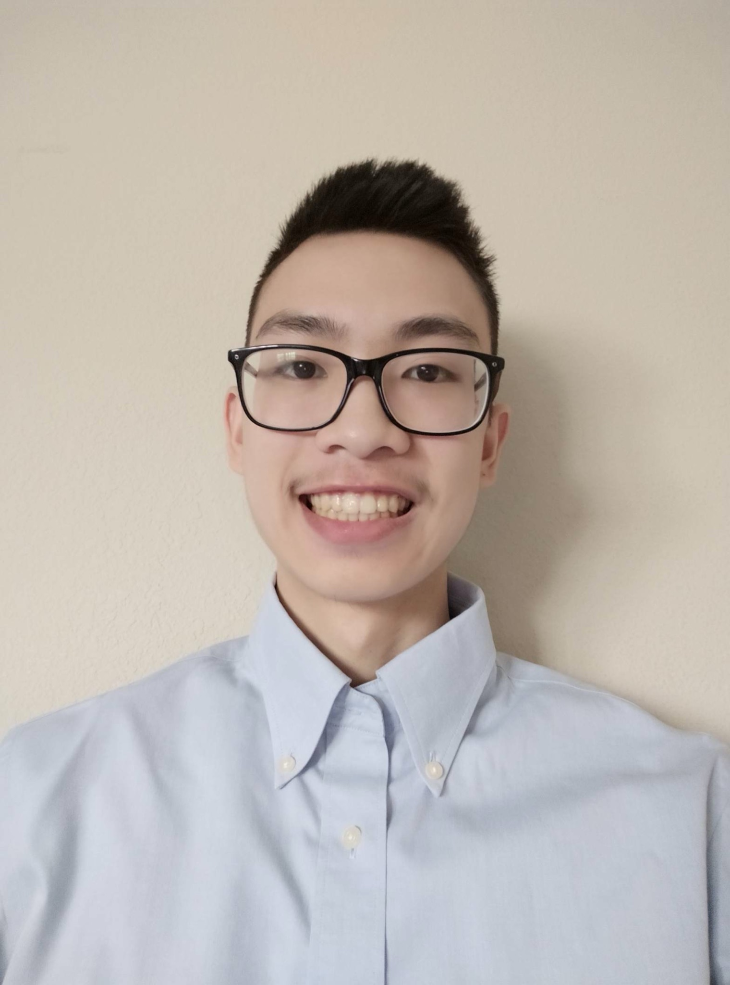
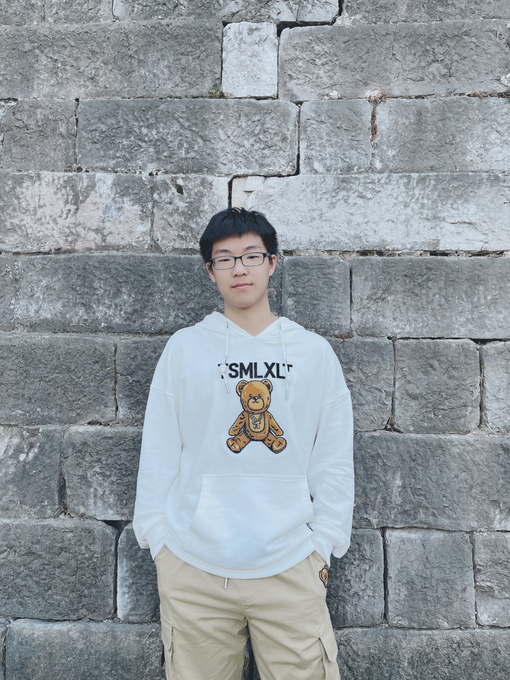
Meet the Innovation-X Team
Isabel Zavian
Senior
Economics & Data Science
Management Lead
Noor-Ul-Ain Ali
Senior
Data Science
Technical Lead
Ronel Solomon
Junior
Data Science
Technical Member
Charline Shen
Junior
Computer Science & Physics
Volunteer Intern
Andy Lam
Senior
Mechanical Engineering
Volunteer Intern
Peter Li
Sophomore
Applied Math & Computer Science
Volunteer Intern

